Slide 1
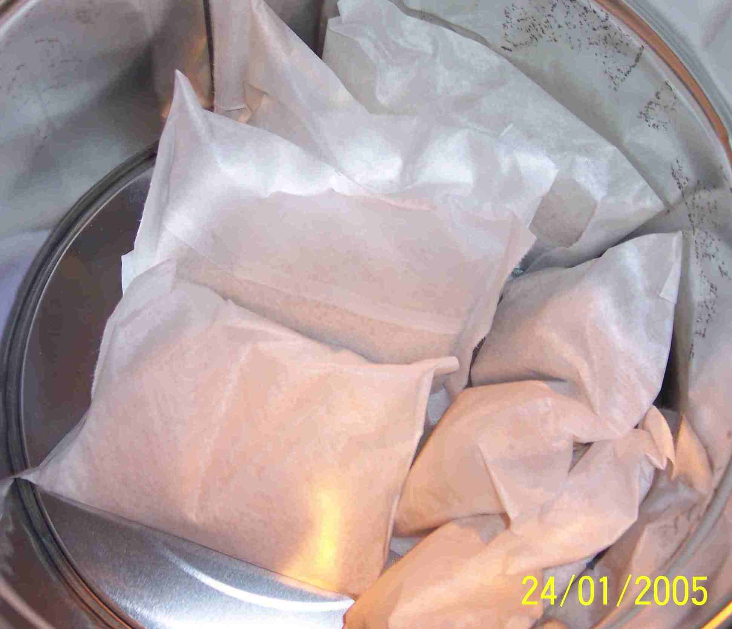
SIEMENS
HVCB SPARES
Filter material for Pole
72.5KV,40KA, 145KV & 245KV CB
S4802585001

